Slide 1
ANDREW FILE SYSTEM
Guided By : Prof. Rakesh Kadkol
By : Hemanth Tubachi 2GI18IS015
Laxmi Nyamagoud 2GI18IS020 Rachana Kampli 2GI18IS032 Rohan Kokatanur 2GI18IS066

Slide 2
File System
Distributed File System
A file system is a process of managing how and where data is stored on a storage disk.
In computing, File System controls how data is stored and retrieved.
By separating the data into pieces and giving each piece a name, the data is easily isolated and identified, which is done by the File System.
A Distributed File System (DFS) as the name suggests, is a file system that is distributed on multiple file servers or multiple locations. It allows programs to access or store isolated files as they do with the local ones, allowing programmers to access files from any network or computer.

Slide 3
Introduction - Andrew File System
Andrew File System (AFS) is one of the distributed file systems that been developed at Carnegie Mellon University (CMU) for use as a campus computing the information system.
AFS is designed to be heterogeneous, scalable, it runs efficiently on variations of UNIX.
AFS provide scalability to thousands of workstation at one site while offering the conveniences of a shared file system.
The design of AFS reflects an intention to support information sharing on a large scale by minimizing client-server communication.
It is a homogeneous, location-transparent file name space to all the client workstations.

Slide 4
Characteristics
AFS has two unusual design characteristics:
Whole-file serving:
The entire contents of directories and files are transmitted to client computers by AFS servers (in AFS-3, files larger than 64 kbytes are transferred in 64-kbyte chunks)
Whole-file caching:
Once a copy of a file has been transferred to a client, it is stored in a local cache disk.
The cache contains several files most recently used on that computer. The cache is permanent.
Local copies of files are used to satisfy clients’ open requests in preference to remote copies whenever possible.

Slide 5
Here is a simple scenario illustrating the operation of AFS:
When a user process in a client computer issues an open system call for a file in the shared file space and there is not a current copy of the file in the local cache, the server holding the file is located and is sent a request for a copy of the file.
The copy is stored in the local UNIX file system in the client computer. The copy is then opened and the resulting UNIX file descriptor is returned to the client.

Slide 6
Here is a simple scenario illustrating the operation of AFS:
(cont)
Subsequent read, write and other operations on the file by processes
in the client computer are applied to the local copy.
4. When the process in the client issues a close system call, if the local
copy has been updated its contents are sent back to the server. The
server updates the file contents and the timestamps on the file. The
copy on the client’s local disk is retained in case it is needed again by a
user-level process on the same workstation.

Slide 7
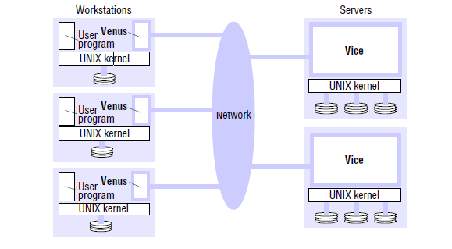
Implementation
AFS is implemented as two software components that exist as UNIX processes called Vice and Venus.
Vice is the name given to the server software that runs as a user-level UNIX process in each server computer.
Venus is a user-level process that runs in each client computer and corresponds to the client module in our abstract model.

Slide 8
Implementation (cont)
The files available to user processes running on workstations are either local or shared.
Local files are handled as normal UNIX files. They are stored on a workstation’s disk and are available only to local user processes. Shared files are stored on servers, and copies of them are cached on the local disks of clients..

Slide 9
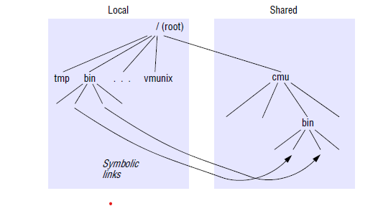
File-name space seen by clients
It is a conventional UNIX directory hierarchy, with a specific subtree (called cmu) containing all of the shared files.
This splitting of the file name space into local and shared files leads to some loss of location transparency, but this is hardly noticeable to users other than system administrators.

Slide 10
Conclusion
AFS demonstrated the feasibility of relatively simple architecture to reduce the cost of maintaining coherent client caches.
AFS outperforms in several situations compare to other distributed file systems.

Slide 11
Thank You

